Slide 1
Module 2.0
Linear Data Structure: Linked List

Slide 2
Memory Allocation & Deallocation for Linked List

Slide 3
Memory Allocation
There are two types of Memory Allocation
Compile Time or Static Allocation
Runtime or Dynamic Allocation

Slide 4
Compile Time or Static Allocation
Memory allocated to the program element
at the start of the program.
Memory allocated
is fixed and determined by the compiler at compile time.
Eg- float a[5] ,
allocation of 20 bytes to the array, i.e. 5*4 bytes

Slide 5
Compile Time or Static Allocation
Inefficient Use of Memory-
Can cause under utilization of memory in case of over allocation
That is if you store less number of elements than the number for elements which which you have declared memory.
Rest of the memory is wasted, as it is not available to other applications.

Slide 6
Compile Time or Static Allocation
Inefficient Use of Memory-
Can cause Overflow in case of under allocation
For float a[5];
No bound checking in C for array boundaries, if you are entering more than fives values,
It will not give error but when these extra element will be accessed, the values will not be available.

Slide 7
Compile Time or Static Allocation
No reusability of allocated memory
Difficult to guess the exact size of the data at the time of writing the program

Slide 8
Runtime or Dynamic Allocation
All Linked Data Structures are preferably implemented through dynamic memory allocation.
Dynamic data structures provide flexibility in adding, deleting or rearranging data objects at run time.
Managed in C through a set of library functions:
malloc()
Calloc()
free()
Realloc()

Slide 9
Runtime or Dynamic Allocation
Memory space required by Variables is calculated and allocated during execution
Get Required chunk of memory at Run time or As the need arises
Best Suited –
When we do not know the memory requirement in advance, which is the case in most of the real life problems.

Slide 10
Runtime or Dynamic Allocation
Efficient use of Memory
Additional Space can be allocated at run time.
Unwanted Space can be released at run time.
Reusability of Memory space

Slide 11
The malloc() fn
Allocates a block of memory in bytes
The user should explicitly give the block size needed.
Request to the RAM of the system to allocate memory,
If request is granted returns a pointer to the first block of the memory
If it fails, it returns NULL
The type of pointer is Void, i.e. we can assign it any type of pointer.
Available in header file alloc.h or stdlib.h

Slide 12
The mallloc() fn
Syntax-
ptr_var=(type_cast*)malloc(size)
ptr_var = name of pointer that holds the starting address of allocated memory block
type_cast* = is the data type into which the returned pointer is to be converted
Size = size of allocated memory block in bytes

Slide 13
The mallloc() fn
Eg-
int *ptr;
ptr=(int *)malloc(10*sizeof(int));
Size of int=2bytes
So 20 bytes are allocated,
Void pointer is casted into int and assigned to ptr
Eg-
char *ptr;
ptr=(char *)malloc(10*sizeof(char));

Slide 14
The mallloc() fn- Usage in Linked List
Eg-
struct student;
{
int roll_no;
char name[30];
float percentage;
};
struct student *st_ptr;
st_ptr=(struct student *)malloc(10*sizeof(struct student));

Slide 15
The callloc() fn
Similar to malloc
It neds two arguments as against one argument in malloc() fn
Eg-
int *ptr;
ptr=(int *)calloc(10,2));
1st argument=no of elements
2nd argument=size of data type in bytes
On initialization-
Malloc() contains garbage value
Calloc() contains all zeros
Available in header file alloc.h or stdlib.h

Slide 16
Malloc() vs callloc() fn
Initialization:
malloc() doesn’t initialize the allocated memory.
If we try to access the content of memory block(before initializing) then we’ll get segmentation fault error(or maybe garbage values).
calloc() allocates the memory and also initializes the allocated memory block to zero.
If we try to access the content of these blocks then we’ll get 0.

Slide 17
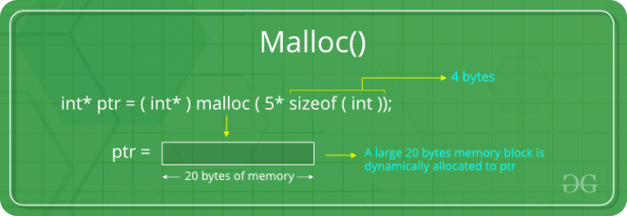
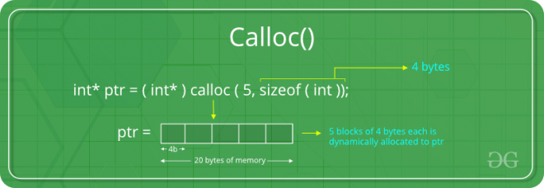
Malloc() vs callloc() fn
Malloc
allocate a single large block of memory with the specified size.
Calloc
allocate multiple blocks of memory
dynamically allocate the specified number of blocks of memory of the specified type.

Slide 18
The free() fn
Used to deallocate the previously allocated memory using malloc or calloc() fn
Syntax-
free(ptr_var);
ptr_var is the pointer in which the address of the allocated memory block is assigned.
Returns the allocated memory to the system RAM..

Slide 19
What happens when you don’t free memory after using malloc()

Slide 20
What happens when you don’t free memory after using malloc()
The memory allocated using malloc() is not de-allocated on its own.
So, “free()” method is used to de-allocate the memory.
But the free() method is not compulsory to use.
If free() is not used in a program
the memory allocated using malloc() will be de-allocated
after completion of the execution of the program
(included program execution time is relatively small and the program ends normally).

Slide 21
What happens when you don’t free memory after using malloc()
Still, there are some important reasons to free() after using malloc():
Use of free after malloc is a good practice of programming.
There are some programs like a digital clock, a listener that runs in the background for a long time and there are also such programs which allocate memory periodically.

Slide 22
What happens when you don’t free memory after using malloc()
Still, there are some important reasons to free() after using malloc():
In these cases, even small chunks of storage add up and create a problem.
Thus our usable space decreases. This is also called “memory leak”.
It may also happen that our system goes out of memory if the de-allocation of memory does not take place at the right time.

Slide 23
The realloc() fn
To resize the size of memory block, which is already allocated using malloc.
Used in two situations:
If the allocated memory is insufficient for current application
If the allocated memory is much more than what is required by the current application

Slide 24
The realloc() fn
Syntax-
ptr_var=realloc(ptr_var,new_size);
ptr_var is the pointer holding the starting address of already allocated memory block.
Available inn header file<stdlib.h>
Can resize memory allocated previously through malloc/calloc only.

Slide 25
Eg of mallloc() fn
#include <stdio.h>
#include <string.h>
#include <stdlib.h>
int main()
{
char *mem_allocation;
/* memory is allocated dynamically */
mem_allocation = malloc( 20 * sizeof(char) );
if( mem_allocation == NULL )
{
printf("Couldn't able to allocate requested memory\n");
}
else
{
strcpy( mem_allocation,"fresh2refresh.com");
}
printf("Dynamically allocated memory content : " \
"%s\n", mem_allocation );
mem_allocation=realloc(mem_allocation,100*sizeof(char));
if( mem_allocation == NULL )
{
printf("Couldn't able to allocate requested memory\n");
}
else
{
strcpy( mem_allocation,"space is extended upto " \
"100 characters");
}
printf("Resized memory : %s\n", mem_allocation );
free(mem_allocation);
}

Slide 26
Which part of the memory is allocated when static memory allocation is used, for int,char,float,arrays,struct,unions…..? Which part of the memory is allocated when malloc and calloc are called for any variable?
??

Slide 27
Stack
Basic type variables such as int, double, etc, and complex types such as arrays and structs. These variables are put on the stack in C.
There is a limit (varies with OS) on the size of variables that can be stored on the stack.
This is not the case for variables allocated on the heap
https://sites.ualberta.ca/dept/chemeng/AIX-43/share/man/info/C/a_doc_lib/aixprggd/genprogc/sys_mem_alloc.htm

Slide 28
Heap
The heap is a region of your computer's memory that is not managed automatically for you, and is not as tightly managed by the CPU.
It is a more free-floating region of memory (and is larger).
Dynamic memory allocation functions allocates memory from the heap.

Slide 29
Heap
To allocate memory on the heap, you must use malloc() or calloc(), which are built-in C functions.
Deallocate memory on heap using free
If you fail to do this, your program will have what is known as a memory leak. That is, memory on the heap will still be set aside (and won't be available to other processes).

Slide 30
Stack vs Heap
Heap –
You must manage memory (you're in charge of allocating and freeing variables)
The heap does not have size restrictions on variable size (apart from the obvious physical limitations of your computer).
Heap memory is slightly slower to be read from and written to, because pointers are used to access memory on the heap.
Variables can be resized using realloc()
variables can be accessed globally
Stack –
Don't have to explicitly de-allocate variables
The stack has size limits
very fast access
variables cannot be resized
local variables only
https://gribblelab.org/CBootCamp/7_Memory_Stack_vs_Heap.html

Slide 31
Stack
Stack resident variables are:
created (“pushed on to”) the stack when a basic block that contains them (i.e. function) is activated and
disappear from (“popped off”) the stack when the function is done
(Those areas of memory that had been used by variables when a basic block was activated may then be overwritten after exit from the block.)
stack memory is more limited, i.e. there is less of it compared to heap memory
http://citeseerx.ist.psu.edu/viewdoc/download;jsessionid=13D3E255880D543426E53785A6A7895F?doi=10.1.1.705.51&rep=rep1&type=pdf

Slide 32
Heap
Heap resident variables include:
variables declared outside all functions (globals)
variables declared inside basic blocks that are declared static
memory areas dynamically allocated at run time with malloc( )
Storage for declared heap resident variables is:
assigned at the time a program is loaded, and
remains assigned for the life of a program

Slide 33
Linked List

Slide 34
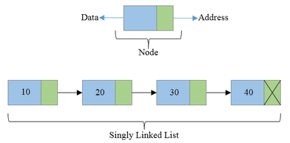
Linked Lists
Linear Collection of data elements called Nodes
where the linear order is given by means of pointers.

Slide 35
Linked Lists
Each node may be divided into atleast two fields for :
Storing Data
Storing Address of next element.
The Last node’s Address field contains Null rather than a valid address.
It’s a NULL Pointer and indicates the end of the list.

Slide 36
Comparison between Array and Linked List

Slide 37
Advantages of Linked List
Linked are Dynamic Data Structures
Grow and shrink during execution of the program
Efficient Memory Utilization
As memory is not preallocated.
Memory can be allocated whenever required and deallocated when not needed.
Insertion and deletions are easier and efficient
Provide flexibility in inserting a data item at a specified position and deletion of a data item from the given position
Many complex applications can be easily carried out with linked lists

Slide 38
Disadvantages of Linked List
Access to an arbitary data item is little bit cumbersome and also time consuming
More memory
If the number of fields are more, then more memory space is needed.

Slide 39
Advantages of Arrays
Simple to use and define
Supported by almost all programming languages
Constant access time
Array element can be accessed a[i]
Mapping by compiler
Compiler maps a[i] too its physical location in memory.
This mapping is carried out in constant time, irrespective of which element is accessed

Slide 40
Arrays suffer from some severe limitations
Disadvantages of Arrays
Static Data Structure-
Size of an array is defined at the time of programming
Insertion and Deletion is time consuming
Requires Contiguous memory

Slide 41
Types of Linked List
Singly Linked List
Doubly Linked List
Circular Linked List

Slide 42
Singly Linked List
All nodes are linked in sequential manner
Linear Linked List
One way chain
It has beginning and end
Problem-
The predecessor of a node cannot be accessed from the current node.
This can be overcome in doubly linked list.

Slide 43
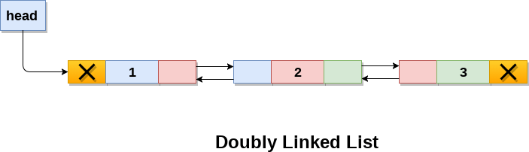
Doubly Linked List
Linked List holds two pointer fields
Addresses of next as well as preceding elements are linked with current node.
This helps to traverse in both Forward or Backward direction

Slide 44
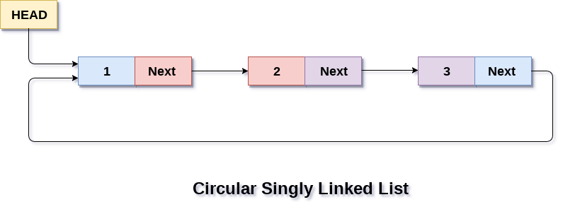
Circular Linked List
The first and last elements are adjacent.
A linked list can be made circular by
Storing the address of the first node in the link field of the last node.

Slide 45
Linked List Operations
Creation
Insertion
Deletion
Traversal
Searching

Slide 46
Implementation of Linked Lists
Structures in C are used to define a node
Address of a successor node can be stored in a pointer type variable

Slide 47
Linked Lists
Information field
struct node
{
int info;
struct node *link;
}
Pointer that points to the structure itself,
Thus Linked List.

Slide 48
Singly Linked List

Slide 49
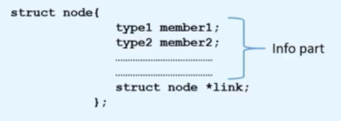
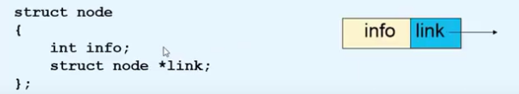

Creation of a new node

Slide 50
Creation of a new node
New node=temp
struct node *tmp;
tmp= (struct node *) malloc(sizeof(struct node));
tmp->info=data;
tmp->link=NULL;

Slide 51
Creating a Linked List
create_list(int data)
{
struct node *q,*tmp;
tmp= (struct node *) malloc(sizeof(struct node));
tmp->info=data;
tmp->link=NULL;
if(start==NULL) /*If list is empty */
{
start=tmp;
}
else
{ /*Element inserted at the end */
q=start;
while(q->link!=NULL)
q=q->link;
q->link=tmp;
}
}/*End of create_list()*/

Slide 52
Traversing a Linked List
Assign the Value of start to another pointer say q
struct node *q=start;
Now q also points to the first element of linked list.
For processing the next element, we assign the address of the next element to the pointer q as-
q=q->link;
Traverse each element of the Linked list through this assignment until pointer q has NULL address, which is link part of last element.
while(q!=NULL)
{
q=q->link;
}

Slide 53
Searching a Linked List
First traverse the linked list
While traversing compare the info part of each element with the given element

Slide 54
Searching a Linked List
search(int data)
{
struct node *ptr = start;
int pos = 1;
while(ptr!=NULL)
{
if(ptr->info==data)
{
printf("Item %d found at position %d\n",data,pos);
return;
}
ptr = ptr->link;
pos++;
}
if(ptr == NULL)
printf("Item %d not found in list\n",data);
}/*End of search()*/

Slide 55
Insertion into a Linked List
Insertion is possible in two ways:
Insertion at Beginning
Insertion in Between

Slide 56
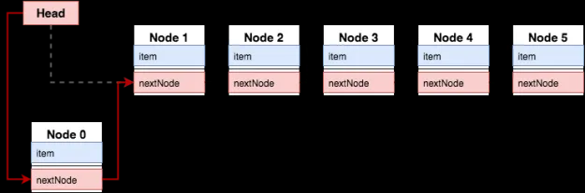
Case 1- Insertion at Beginning

Slide 57
Case 1- Insertion at Beginning
create the new node,
connect New Node to the OLD First NODE
Connect the Start Pointer to the new node,
……

Slide 58
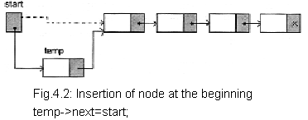
Case 1- Insertion at Beginning
Lets say tmp is the pointer which points to the node that has to be inserted
Assign data to the new node
tmp->info=data;
Start points to the first element of linked list
Assign the value of start to the link part of the inserted node as
tmp->link=start;
Now inserted node points beginning of the linked list.
To make the newly inserted node the first node of the linked list:
start=temp

Slide 59
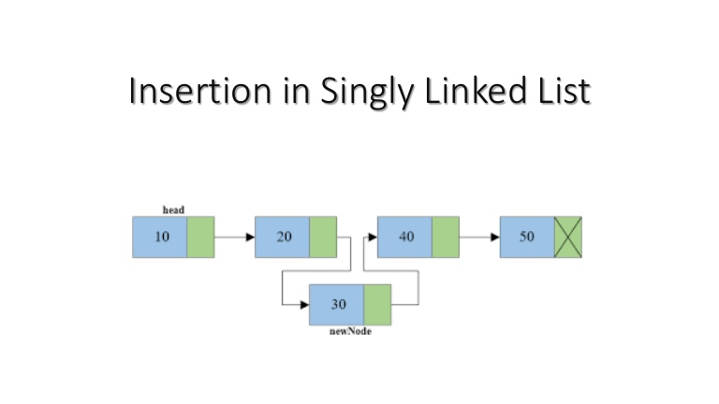
Case 2- Insertion in Between

Slide 60
Case 2- Insertion in Between
create the New node ,
connect the nEW node to the next node
connect the previous to the new node,
……

Slide 61
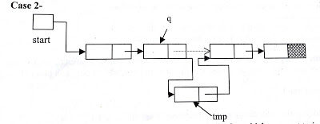
Case 2- Insertion in Between
First we traverse the linked list for obtaining the node after which we want to insert the element
q=start;
for(i=0;i<pos-1;i++)
{
q=q->link;
if(q==NULL)
{
printf("There are less than %d elements",pos);
return;
}
}/*End of for*/

Slide 62
Case 2- Insertion in Between
Then we add the new node by adjusting address fields
tmp->info=data;
tmp->link=q->link;
q->link=tmp;

Slide 63
Deletion from a Linked List
For deleting the node from a linked list, first we traverse the linked list and compare with each element.
After finding the element there may be two cases for deletion-
Deletion in beginning
Deletion in between

Slide 64
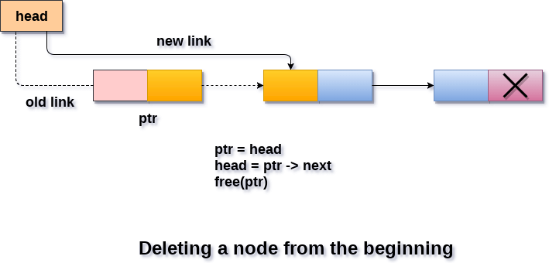
Deletion in beginning

Slide 65
Deletion in beginning
Delete the First node and connect
Start Pointer to the second node……

Slide 66
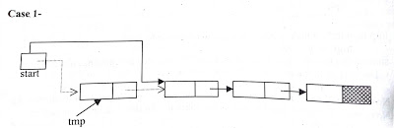
Deletion in beginning
Start points to the first element of linked list.
If element to be deleted is the first element of linked list then we assign the value of start to tmp as-
tmp = start;
So tmp points to the first node which has to be deleted.
Now assign the link part of the deleted node to start as-
start=start->link;
Since start points to the first element of linked list, so start->link will point to the second element of linked list.
Now we should free the element to be deleted which is pointed by tmp. free( tmp );

Slide 67
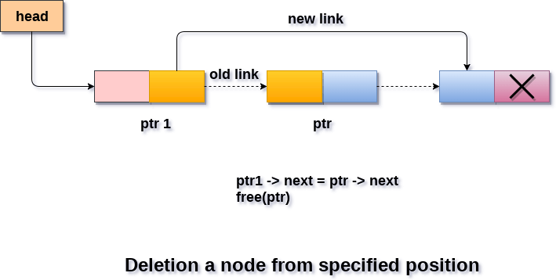
Deletion in between

Slide 68
Deletion in between
Delete the node and connect
the previous and the next node……

Slide 69
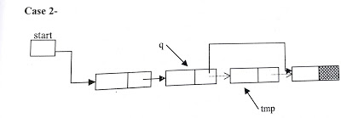
Deletion in between
If the element is other than the first element of linked list then
we give the link part of the deleted node to the link part of the previous node.
This can be as-
tmp =q->link;
q->link = tmp->link;
free(tmp);

Slide 70
Deletion in between
If node to be deleted is last node of linked list then statement 2 will be as-
tmp =q->link;
q->link = NULL;
free(tmp);

Slide 71
Complexity of operations in Linked List:
Access/Traverse
It is not possible to have a constant access time in linked list operations.
The data required may be at the other end of the list and the worst case may be to traverse the whole list to get it.
The time complexity is hence O(n).
Arrays-
It’s just O(1) for array because of constant access time using a[i]

Slide 72
Complexity of operations in Linked List:
Insertion
Insertion in a linked list involves only manipulating the pointers of the previous node and the new node, provided we know the location where the node is to be inserted.
Thus, the insertion of an element is O(1).
Deletion
Similar to insertion, deletion in a linked list involves only manipulating the pointers of the previous node and freeing the new node, provided we know the location where the node is to be deleted.
Thus, the deletion of an element is O(1).
In order to delete a node and connect the previous and the next node together, you need to know their pointers.

Slide 73
Complexity of operations in Linked List:
Insertion and deletion at a known position is O(1).
However, finding that position is O(n), unless it is the head (Singly linked list) or tail of the list(Circular Linked list).
In a doubly-linked list, both next and previous pointers are available in the node that is to be deleted. The time complexity is constant in this case, i.e., O(1)
When we talk about insertion and deletion complexity, we generally assume we already know where that's going to occur.

Slide 74
Time complexity for Search Operation in Singly Linked List
Best Case-
Element found in the first node, while loop executes only once so O(1)
Worst Case-
Element present in the last node so while node will work n times so O(n)
Courtesy of https://www.youtube.com/watch?v=lWEBpaVPoJA

Slide 75

Courtesy of https://www.bigocheatsheet.com/

Slide 76
Circular Linked List

Slide 77
Why Circular?
In a singly linked list,
If we are at any node in the middle of the list, then it is not possible to access nodes that precede the given node.
This problem can be solved by slightly altering the structure of singly linked list.

Slide 78
How?
In a singly linked list, next part (pointer to next node) of the last node is NULL,
if we utilize this link to point to the first node then we can reach preceding nodes.

Slide 79

Implementation of circular linked list
Creation of circular linked list is same as single linked list.
Last node will always point to first node instead of NULL.

Slide 80
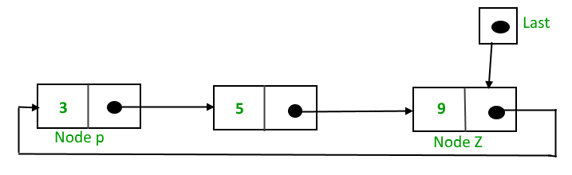
Implementation of circular linked list
One pointer last,
which points to last node of list and link part of this node points to the first node of list.

Slide 81
Advantages of a Circular linked list
In circular linked list, we can easily traverse to its previous node, which is not possible in singly linked list.
Entire list can be traversed from any node.
If we are at a node, then we can go to any node. But in linear linked list it is not possible to go to previous node.

Slide 82
Advantages of a Circular linked list
In Single Linked List, for insertion at the end, the whole list has to be traversed.
In Circular Linked list,
with pointer to the last node there won’t be any need to traverse the whole list.
So insertion in the begging or at the end takes constant time irrespective of the length of the list i.e O(1).
It saves time when we have to go to the first node from the last node.
It can be done in single step because there is no need to traverse the in between nodes

Slide 83
Disadvantages of Circular linked list
Circular list are complex
as compared to singly linked lists.
Reversing of circular list is a complex
as compared to singly or doubly lists.
If not traversed carefully,
then we could end up in an infinite loop.
Like singly and doubly lists circular linked lists also doesn’t supports direct accessing of elements.

Slide 84
Insertion into a circular linked list :-
Insertion in a circular linked list may be possible in two ways-
Insertion in an empty list
Insertion at the end of the list
Insertion at beginning
Insertion in between

Slide 85

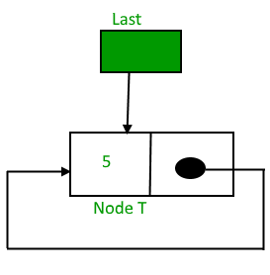
Insertion in an empty list
New element can be added as-
If linked list is empty:
If (last==NULL)
{
last=tmp;
tmp->link=last
}

Slide 86
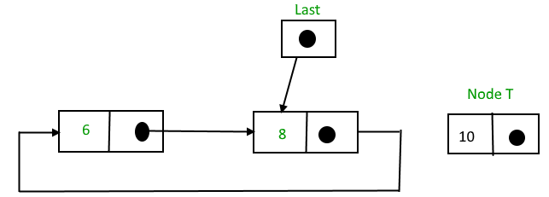
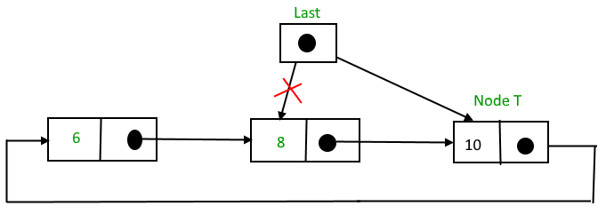
Insertion at the end of circular linked list
If linked list is not empty:
Insertion at the end of the list
{
tmp->link = last->link; /* added at the end of list*/
last->link = tmp;
last = tmp;
}
Last pointer shifted
3
2
1

Slide 87
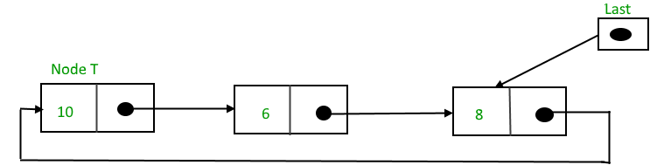
Insertion at the beginning of circular linked list
If linked list is not empty:
Insertion at the beginning of the list Follow these step: 1. Create a node, say tmp. 2. Make tmp-> next = last -> next. 3. last -> next = tmp.
Last pointer not shifted !!
1
2

Slide 88
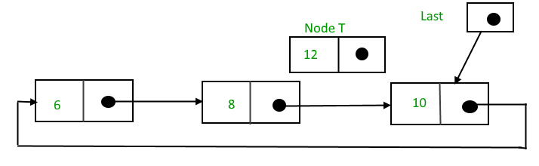
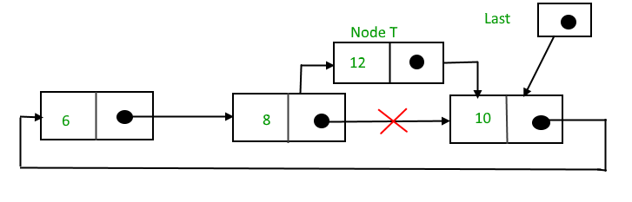
Insertion in between of circular linked list
Insertion in between is same as in single linked list. This can be as-
tmp->link = q->link;
tmp->info = num;
q->link =tmp;
Here q points to the node after which new node will be inserted.

Slide 89
Traversal of circular linked list
Pointer variable which points to first node of list is needed.
Here we maintain the pointer last which points to last node.
But link part of this last pointer points to first node of list,
So we can assign this value to pointer variable which will point to first node.
Now we can traverse the list until the last node of list comes-
q = last->link;
while(q != last)
{
..........
q = q->link;
}

Slide 90
Deletion from a circular linked list :-
Deletion in a circular linked list may be possible in four ways-
If list has only one element
Node to be deleted is the first node of list
Deletion in between
Node to be deleted is last node of list

Slide 91
Deletion from a circular linked list :-
Case 1:- If list has only one element
Here we check the condition for only one element of list
then assign NULL value to last pointer because after deletion no node will be in list.
if(last->link == last && last->info == num) /* Only one element */
{
tmp = last;
last = NULL;
free(tmp);
}

Slide 92
Deletion from a circular linked list :-
Case 2:- Node to be deleted is the first node of list
Assign the link part of deleted node to the link part of pointer last.
So now link part of last pointer will point to the next node which is now first node of list after deletion.
q = last->link; /*q is pointing to the first node of list*/
if(q->info == num)
{
tmp = q;
last->link = q->link;
free(tmp);
}

Slide 93
Deletion from a circular linked list :-
Case 3:- Deletion in between is same as in single linked list.
Deletion of node in between will be as-
q = last->link;
while(q->link != last)
{
if(q->link->info == num) /* Element deleted in between */
{
tmp = q->link;
q->link = tmp->link;
free(tmp);
}
q = q->link;
} /* End of while */
First we are traversing the list, when we find the element to be deleted,
then q points to the previous node.
We assign the link part of node to be deleted to the link part of previous node and
then we free the address of node to be deleted from memory.
As we need to stop at the previous node for deletion

Slide 94
Deletion in between in Singly Linked List
If the element is other than the first element of linked list then
we give the link part of the deleted node to the link part of the previous node.
This can be as-
tmp =q->link;
q->link = tmp->link;
free(tmp);

Slide 95
Deletion from a circular linked list :-
Case 4:- Deletion of last node
Assign the link part of last node to the link part of previous node.
So link part of previous node will point to the first node of list.
Then assign the value of previous node to the pointer variable last because after deletion of last node , pointer variable last should point to the previous node.
tmp = q->link;
q->link = last->link;
free(tmp);
last =q;

Slide 96
Doubly Linked List

Slide 97
Doubly Linked List
Drawback of single linked list-
In single linked list,
we can traverse only in one direction because each node has address of next node only.
Suppose we are in the middle of singly linked list and
To do operation with just previous node then we have no way to go on previous node,
We will again traverse from starting node.

Slide 98
Doubly Linked List
Drawback of single linked list-
Solution-
Doubly linked list, in this each node has address of previous and next node also.

Slide 99
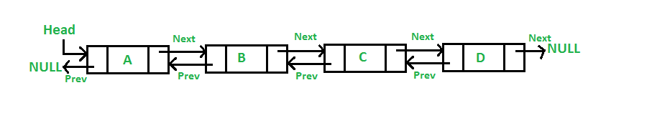
Doubly Linked List

Slide 100
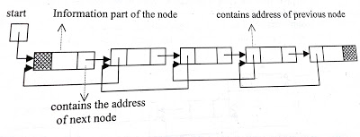
Doubly Linked List
The data structure for doubly linked list will be as-
struct node
{
struct node *prev;
int info;
struct node *next;
}*start;

Slide 101
Doubly Linked List
struct node
{
struct node *prev;
int info;
struct node *next;
}*start;
struct node *previous is a pointer to structure, which will contain the address of previous node
struct node * next will contain the address of next node in the list.
Traversal in both directions at any time.

Slide 102
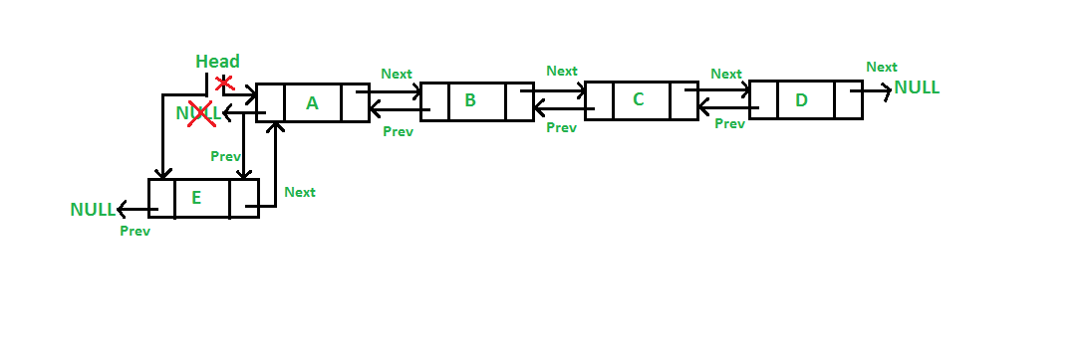
Doubly Linked List-Insertion at beginning
A 5 steps process

Slide 103
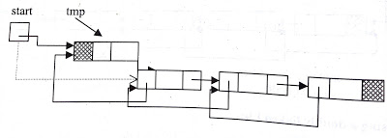
Doubly Linked List-Insertion at beginning
Start points to the first node of doubly linked list.
Assign the value of start to the next part of inserted node and address of inserted node to the prev part of start as-
tmp->next=start;
tmp->info=data
start->prev = tmp;
Now inserted node points to the next node, which was beginning node of the doubly linked list and
prev part of second node will point to the new inserted node. Now inserted node is the first node of the doubly linked list.

Slide 104
Doubly Linked List-Insertion at beginning
So start will be reassigned as-
start= tmp;
Now start will point to the inserted node which is first node of the doubly linked list.
Assign NULL to prev part of inserted node since now it will become the first node and prev part of first node is NULL-
tmp->prev=NULL;

Slide 105
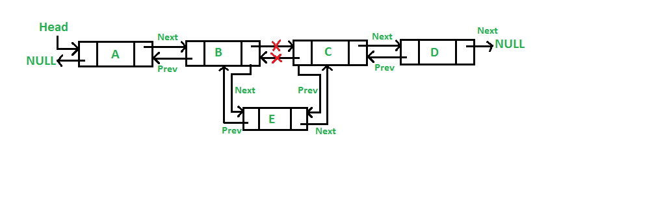
Doubly Linked List-Insertion in between

Slide 106
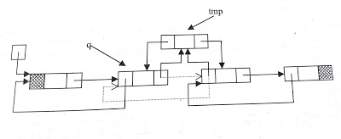
Doubly Linked List-Insertion in between
Traverse to obtain the node (q) after which we want to insert the element.
Assign the address of inserted node(tmp) to the prev part of next node.
q->next->prev=tmp;
Assign the next part of previous node to the next part of inserted node.
tmp->next=q->next;
Address of previous node will be assigned to prev part of inserted node
tmp->prev=q;
Address of inserted node will be assigned to next part of previous node.
q->next=tmp;

Slide 107
Deletion from doubly linked list
Traverse the linked list and compare with each element. After finding the element there may be three cases for deletion-
Deletion at beginning
Deletion in between
Deletion of last node

Slide 108
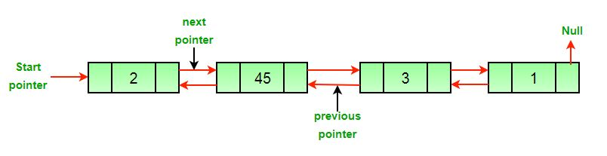
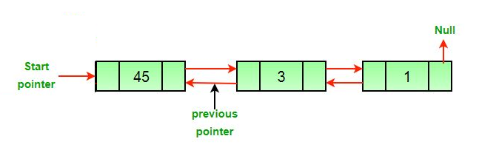
Deletion from doubly linked list-Deletion at beginning

Slide 109
Doubly linked list-Deletion at beginning
Assign the value of start to tmp as-
tmp = start;
Now we assign the next part of deleted node to start as-
start=start->next;
Since start points to the first node of linked list, so start->next will point to the second node of list.
Then NULL will be assigned to start->prev.
start->prev = NULL;
Now we should free the node to be deleted which is pointed by tmp.
free( tmp );

Slide 110
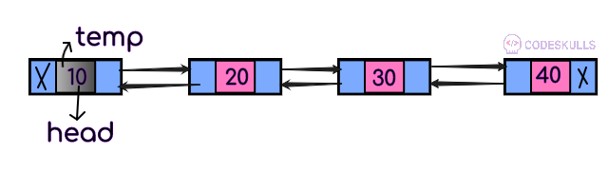
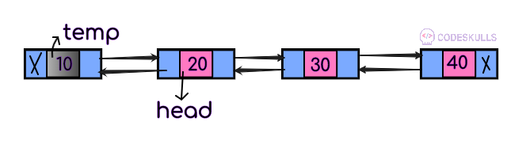
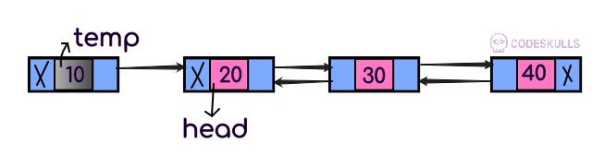
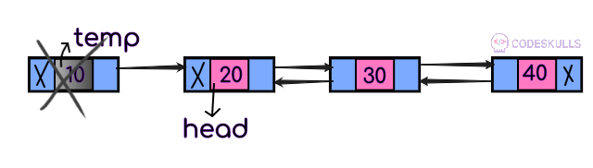
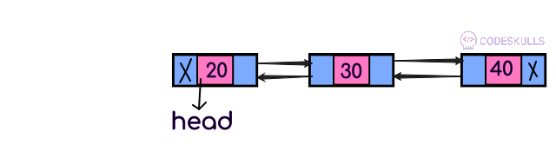
Doubly linked list-Deletion at beginning
Assign the value of start to tmp as-
tmp = start;
Now we assign the next part of deleted node to start as-
start=start->next;
Since start points to the first node of linked list, so start->next will point to the second node of list.
Then NULL will be assigned to start->prev.
start->prev = NULL;
Now we should free the node to be deleted which is pointed by tmp.
free( tmp );

Slide 111
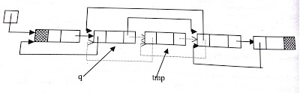
Deletion from doubly linked list-Deletion in between
If the element is other than the first element of linked list
then we assign the next part of the deleted node to the next page of the previous node
address of the previous node to prev part of next node. This can be as-
tmp=q->next;
q->next=tmp->next;
tmp->next->prev=q;
free(tmp);
Here q is pointing to the previous node of node to be deleted.
After statement 1 tmp will point to the node to be deleted.
After statement 2 next part of previous node will point to next node of the node to be deleted
After statement 3 prev part of next node will point to previous node.

Slide 112
Doubly linked list-Deletion of last node
If node to be deleted is last node of doubly linked list then
we will just free the last node and
tmp=q->next;
free(tmp);
next part of second last node will be NULL.
q->next=NULL;
Here q is second last node
After statement 1, tmp will point to last node
After statement 2 last node will be deleted and after statement 3 second last node will become the last node of list.

Slide 113
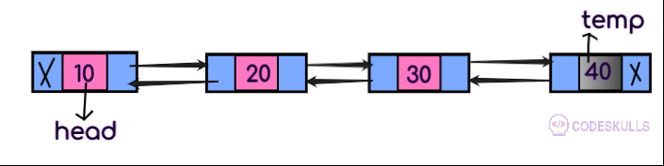
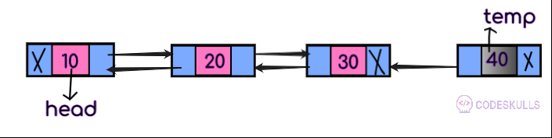
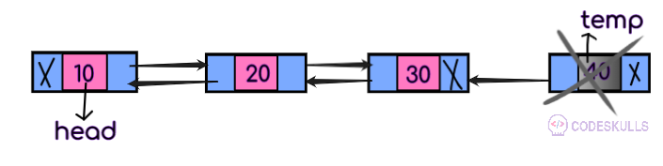
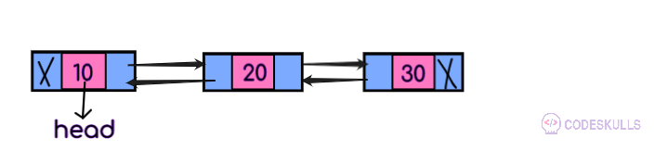
Doubly linked list-Deletion of last node
If node to be deleted is last node of doubly linked list then
we will just free the last node and
tmp=q->next;
free(tmp);
next part of second last node will be NULL.
q->next=NULL;
Here q is second last node
After statement 1, tmp will point to last node
After statement 2 last node will be deleted and after statement 3 second last node will become the last node of list.

Slide 114
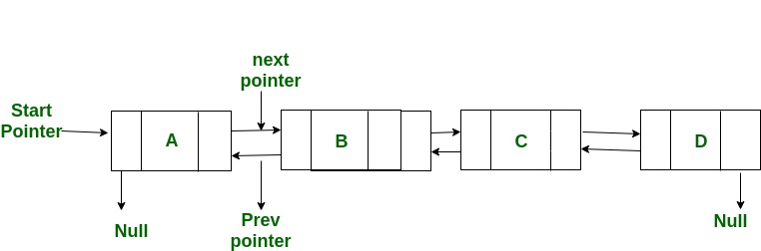
XOR List Representation:
Ordinary Representation:
Node A: prev = NULL, next = add(B) // previous is NULL and next is address of B
Node B: prev = add(A), next = add(C) // previous is address of A and next is address of C
Node C: prev = add(B), next = add(D) // previous is address of B and next is address of D
Node D: prev = add(C), next = NULL // previous is address of C and next is NULL
Let us call the address variable in XOR representation as npx (XOR of next and previous)
Node A: npx = 0 XOR add(B) // bitwise XOR of zero and address of B
Node B: npx = add(A) XOR add(C) // bitwise XOR of address of A and address of C
Node C: npx = add(B) XOR add(D) // bitwise XOR of address of B and address of D
Node D: npx = add(C) XOR 0 // bitwise XOR of address of C and 0

Slide 115
Polynomial arithmetic with linked list
One useful application of linear linked list
Linked list can be used
to represent polynomial expression
for arithmetic operations also.

Slide 116
Polynomial arithmetic with linked list
Let us take a polynomial expression-
5x⁴ + x³ - 6x + 2
Here we can see every symbol x is attached with two things,
coefficient
exponent.
As in 5x⁴ , coefficient is 5 and exponent is 4.
So we can represent polynomial expression in single linked list
where each node of list will contain the coefficient and exponent of each term of polynomial expression.

Slide 117
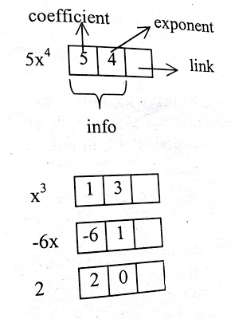
Polynomial arithmetic with linked list

Slide 118
Polynomial arithmetic with linked list
So the data structure for polynomial expression will be-
struct node{
int coefficient;
int exponent;
struct node *link;
}

Slide 119

Descending sorted linked list is used based on the exponent because it will be easier for arithmetic operation with polynomial linked list.
Otherwise, we have a need to traverse the full list for every arithmetic operation.
Now we can represent polynomial expression 5x⁴ + x³ - 6x + 2 as-
5
Notes:
5x^2+1x^3-6x^1+2

Slide 120
Creation of polynomial linked list
Creation of polynomial linked list will be same as
creation of sorted linked list but
it be in descending order and based on exponent of symbol.

Slide 121
Creation of polynomial linked list
In if condition we are checking for the node to be added will be first node or not.
/* list empty or exp greater than first one */
if(start==NULL || ex> start->expo)
{
tmp->link=start;
start=tmp;
return start;
}

Slide 122
Creation of polynomial linked list
else
{
ptr=start;
while(ptr->link!=NULL && ptr->link->expo > ex)
{
ptr=ptr->link;
}
tmp->link=ptr->link;
ptr->link=tmp;
if(ptr->link==NULL) /* item to be added in the end */
tmp->link=NULL;
}
In else part
we traverse the list and
check the condition for exponent then
we add the node at proper place in list.
If node will be added at the end of list then
we assign NULL in link part of added node.

Slide 123
Creation of polynomial linked list
Lets insert 9x²
Let ex=2
Ptr=1st Node
Check if ptr->link->expo > ex
Check if 2nd node’s expo >ex
If 3>2, yes
Then
Ptr=ptr->link
Ptr=2nd node
Check if ptr->link->expo>ex
Check if 3rd node’s expo>ex
If 1>2, no
Insert the new node here
9 | 2

Slide 124
Addition with polynomial linked list
Input :
p1= 13x⁸ + 7x⁵ + 32x² + 54
p2= 3x¹² + 17x⁵ + 3x³ + 98
Output : 3x¹² + 13x⁸ + 24x⁵ + 3x3 + 32x² + 152

Slide 125
Addition with polynomial linked list
For addition of two polynomial linked list, we have a need to traverse the nodes of both the lists.
If the node has exponent value higher than another, then
that node will be added to the resultant list or
we can say that nodes which are unique to both the lists will be added in the resultant list.

Slide 126
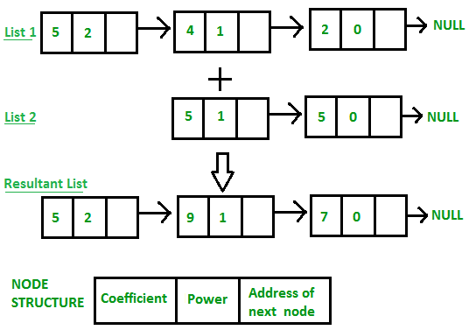
Addition with polynomial linked list
If the nodes have same exponent value then
first the coefficient of both nodes will be added
then the result will be added to the resultant list.
Suppose in traversing one list is finished then
remaining node of the another list will be added to the resultant list.

